Slide 1




Slide 2
Safety in Soapmaking

Slide 3

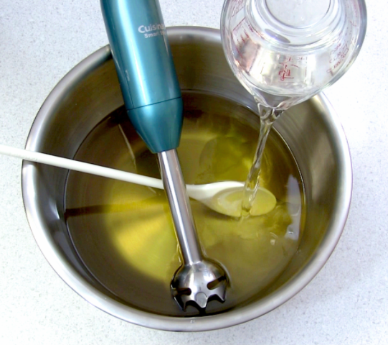
Safety in Soapmaking
Always add lye to water.
Put your lye into the water, not the other way round, to prevent dangerous splashes or severe volcanic reactions. When mixing with oils, add the lye water to the oils. Lye is always the ingredient that does the pouring.

Slide 4
Safety in Soapmaking
Always add lye to water.
Put your lye into the water, not the other way round, to prevent dangerous splashes or severe volcanic reactions. When mixing with oils, add the lye water to the oils. Lye is always the ingredient that does the pouring.

Slide 5


